Slide 1
Theoretical Perspectives on Human Behavior

Slide 2
Multiple Perspectives
Theories
  Are useful for thinking about changing configurations of persons and environments
  Are overlapping and intersecting
  Differ by focus and perspective
  Evolve as world views expand and change based on society
  Used to guide practice interventions
Hutchison, Dimensions of Human Behavior, 6e
SAGE Publishing, 2019
2

Slide 3
Systems Perspective
Human behavior is the outcome of interaction within and among systems of interrelated parts
  Systems are made up of interrelated members (parts) that constitute an ordered whole
  Each part impacts all other parts and the system as a whole
  Systems are subsystems of other larger systems
  Maintain boundaries that give them their identities
Hutchison, Dimensions of Human Behavior, 6e
SAGE Publishing, 2019
3

Slide 4
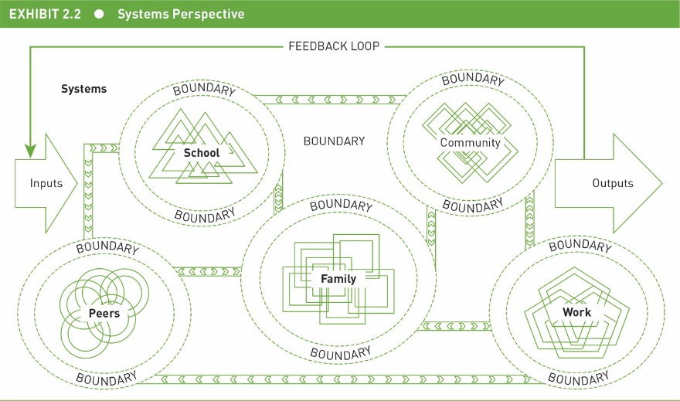
Systems Perspective
Hutchison, Dimensions of Human Behavior, 6e
SAGE Publishing, 2019
6

Slide 5
Conflict Perspective
Conflicts arise due to inequalities in resource distribution
People try to advance their own interests over the interests of others
Power is unequally divided as some social groups dominate others
Non-dominant groups are manipulated and controlled by dominant groups
Hutchison, Dimensions of Human Behavior, 6e
SAGE Publishing, 2019
8

Slide 6
Conflict Perspective
Lack of open conflict is a sign of exploitation
Non-dominant group members become alienated from society
Social change is driven by conflict, with periods of change interrupting long periods of stability
Hutchison, Dimensions of Human Behavior, 6e
SAGE Publishing, 2019
9

Slide 7
Conflict Perspective
  Examples of conflict perspectives
    Critical theory
    Neoliberalism theory
    Critical race theory
    Feminist theories
    Intersectionality theories
Hutchison, Dimensions of Human Behavior, 6e
SAGE Publishing, 2019

Slide 8
Exchange and Choice Perspective
Focus on the processes whereby individual and collective actors seek and exchange resources and the choices made in pursuit of those resources
People are rational and goal-directed
Try to maximize rewards/minimize cost
Values, standards, expectations, and alternatives influence assessment of rewards and costs
Reciprocity of exchange is essential to social life
Power comes from unequal resources in an exchange
Hutchison, Dimensions of Human Behavior, 6e
SAGE Publishing, 2019
13

Slide 9
Exchange and Choice Perspective
Examples of exchange and choice perspectives
  Social exchange theory
  Rational choice theory
  Social network theory
  Social capital theory
Hutchison, Dimensions of Human Behavior, 6e
SAGE Publishing, 2019
14

Slide 10
Social Constructionist Perspective
How people construct meaning, sense of self, and a social world through interactions with each other
  Learn through interactions to classify the world and their place in it
  Interaction regularly reshapes reality
Hutchison, Dimensions of Human Behavior, 6e
SAGE Publishing, 2019
15

Slide 11
Social Constructionist Perspective
People perform for their social audiences, but they are also free, active, and creative
  Social interaction is grounded in language customs, as well as cultural and historical contexts
  Society consists of social processes, not structures
Hutchison, Dimensions of Human Behavior, 6e
SAGE Publishing, 2019
16

Slide 12
Social Constructionist Perspective
  Examples of social constructionist perspectives
    Symbolic interaction theory
    Postmodern theories
    Phenomenological sociology
Hutchison, Dimensions of Human Behavior, 6e
SAGE Publishing, 2019

Slide 13
Developmental Perspective
How behavior unfolds across the life course, how people change and stay the same over time
Development occurs in clearly defined stages
Human development is a complex interaction of biological, psychological, and social factors
Each stage of life is qualitatively different from all other stages and builds on earlier stages
Moving from one stage to the next involves new tasks and changes in statuses and roles
Hutchison, Dimensions of Human Behavior, 6e
SAGE Publishing, 2019
24

Slide 14
Developmental Perspective
Examples of developmental perspectives
  Life span/life cycle theory
  Social identity theory
Hutchison, Dimensions of Human Behavior, 6e
SAGE Publishing, 2019

Slide 15
Behavioral Perspective
Behavior is learned as individuals interact with their environment
Similar learning processes taking place in different environments produce differences in behavior
All human problems can be formulated as undesirable behavior
All behavior can be defined and changed
Behavior is learned by association of environmental stimuli, by reinforcement, by imitation, and by personal expectations and meanings
Hutchison, Dimensions of Human Behavior, 6e
SAGE Publishing, 2019
28

Slide 16
Behavioral Perspective
Examples of behavioral perspectives
  Cognitive social learning theory
  Cognitive behavioral theory/therapy
Hutchison, Dimensions of Human Behavior, 6e
SAGE Publishing, 2019

Slide 17
Humanistic Perspective
Emphasizes individual’s freedom of action and search for meaning
Each person is unique and valuable
People always have the capacity to change themselves, even to make radical change
Hutchison, Dimensions of Human Behavior, 6e
SAGE Publishing, 2019
31

Slide 18
Humanistic Perspective
Human behavior can be understood only from the vantage point of the phenomenal self—from the internal frame of reference of the individual
People make psychologically destructive demands on each other, and attempts to meet those demands produce anxiety
Human behavior is driven by a desire for growth, personal meaning, and competence, and by a need to experience a bond with others
Hutchison, Dimensions of Human Behavior, 6e
SAGE Publishing, 2019
32

Slide 19
Humanistic Perspective
  Transpersonal theory
  Rogers’ client-centered approach to therapy
  Post-humanist approach
  Humanistic theory of organizations
  Appreciative inquiry theory
Hutchison, Dimensions of Human Behavior, 6e
SAGE Publishing, 2019

Slide 20
Merits of Multiple Perspectives
All theories seek to understand human behavior, but different phenomena are emphasized in each
Theories guide social work practice
Use multiple perspectives in integrated fashion to see many dimensions
Flexible and reflecting in thinking and “doing”
Provides better overall picture of the individual, their family, and the situation
Hutchison, Dimensions of Human Behavior, 6e
SAGE Publishing, 2019
36

Slide 21
Chapter 1
Human Behavior:
A Multidimensional Approach

Slide 22
Human Behavior: Individual and Collective
Person and their environments
  Essential considerations in social work practice
Time
  Important to consider
  People and environments are dynamic—constantly changing
Hutchison, Dimensions of Human Behavior, 6e
SAGE Publishing, 2019

Slide 23
A Multidimensional Approach
Dimension
  Can be focused on separately
  BUT
  Cannot be understood without considering other features
  How dimensions interact determines behavior
Multi-determined behavior
  Behavior that develops as a result of many causes
Hutchison, Dimensions of Human Behavior, 6e
SAGE Publishing, 2019

Slide 24
Personal Dimensions
Biopsychosocial approach
  Composed of biology, psychology, and social systems factors or perspectives
  Components interact with each other
Argument for greater attention to the spiritual dimension of persons
Focus on
  Biological, psychological, and spiritual
Hutchison, Dimensions of Human Behavior, 6e
SAGE Publishing, 2019
Notes:
Example: David is a veteran whom struggles with post-traumatic stress disorder (PTSD) from his time spent in Afghanistan. Social workers would look at his biology (i.e., any familial history of PTSD or psychiatric disorders, brain trauma, internal chemical imbalances), psychology (i.e., personality, mood, coping skills), and social factors (i.e., friends, job, housing situation, substance use) to best determine how to help him. In addition to looking at these individually, it will be vital to look at how these affect each other. For example, if David was homeless how would that affect his ability to have enough to eat? His ability to seek medical help? If he self-medicated with alcohol, how would this affect his homelessness and ability to hold a job?

Slide 25
Environmental Dimensions
Bronfenbrenner (2005)
  Microsystems
  Mesosystems
  Exosystems
  Macrosystems
  Chronosystems
Hutchison, Dimensions of Human Behavior, 6e
SAGE Publishing, 2019

Slide 26
Environmental Dimensions
Physical
Culture
Social structure and social institutions
Formal organization
Community
Social movements
Small groups
Families
Dyads
Hutchison, Dimensions of Human Behavior, 6e
SAGE Publishing, 2019

Slide 27
Time Dimensions
Dimensions not only interact dynamically, but also change over time
Linear time
  View of time in order from past–present–future
Historical era
  Specific block or time period in which individuals and collective lives are enacted
Hutchison, Dimensions of Human Behavior, 6e
SAGE Publishing, 2019

Slide 28
Time Dimensions
Chronological age
  Change experienced over the course of life
  From birth to death
Hutchison, Dimensions of Human Behavior, 6e
SAGE Publishing, 2019

Slide 29
Time Dimensions
The concept of time differs by culture
  Industrialized countries
    Clock time and orientation to the future
  Less industrialized countries
    Event time and orientation to the past
Hutchison, Dimensions of Human Behavior, 6e
SAGE Publishing, 2019

Slide 30
Time Dimensions
Zimbardo and Boyd (2008)
  Past-positive
  Past-negative
  Present-hedonistic
  Present-fatalistic
  Future
  Transcendental-future
Hutchison, Dimensions of Human Behavior, 6e
SAGE Publishing, 2019

Slide 31
A Multidimensional Approach:
Dimensions in Our Lives
Discuss
  A person dimension in your life
  An environmental dimension in your life
  A time dimension in your life
How do they interact with each other?
  What effect does that have on your life?
Hutchison, Dimensions of Human Behavior, 6e
SAGE Publishing, 2019

Slide 32
Diversity, Inequality, and the Pursuit of Social Justice
Global perspective
  Awareness that my view of the world is not universally shared
  Awareness of the diversity of ideas and practices
  Curiosity about conditions in other parts of the world and how they relate to our society
  Understanding of where I fit in the global social structure
Hutchison, Dimensions of Human Behavior, 6e
SAGE Publishing, 2019

Slide 33
Diversity, Inequality, and the Pursuit of Social Justice
  Awareness of how people in other societies view my society
  Understanding of how the world works
Globalization
  process of people becoming more interconnected economically, politically, environmentally, and culturally
Hutchison, Dimensions of Human Behavior, 6e
SAGE Publishing, 2019

Slide 34
Diversity
Increasing racial, ethnic, and religious diversity
Heightened consciousness of human differences
  Gender, cultural, sexual orientation, abilities, disabilities, family forms, and so on
  Heterogeneity
    Differences among individuals
  Diversity
    Differences among groups
Melting pot or pluralism?
Hutchison, Dimensions of Human Behavior, 6e
SAGE Publishing, 2019

Slide 35
Inequality
Gender, race, and class are categorizations used to develop hierarchical social structures that influence social identities and life chances
Privilege—unearned advantage
  White privilege
  U.S. privilege
Social locations—where we fit into a system of social identities
Hutchison, Dimensions of Human Behavior, 6e
SAGE Publishing, 2019

Slide 36
Diversity, Inequality, and the Pursuit of Social Justice
What is meant by…
  “Shifting nature of terminology”
    Why is this important?
  “Privilege” and “disadvantage”
    How are they multidimensional?
Social inequalities on the rise
  Examples?
Hutchison, Dimensions of Human Behavior, 6e
SAGE Publishing, 2019

Slide 37
Advancing Human Rights and Social, Economic, and Environmental Justice
NASW Code of Ethics identifies social justice as one of six core values of social work
Mechanisms of oppression can be used intentionally or unintentionally
  Examples?
Global social justice
Theories of social justice
  Fairness
  Capabilities approach
Hutchison, Dimensions of Human Behavior, 6e
SAGE Publishing, 2019

Slide 38
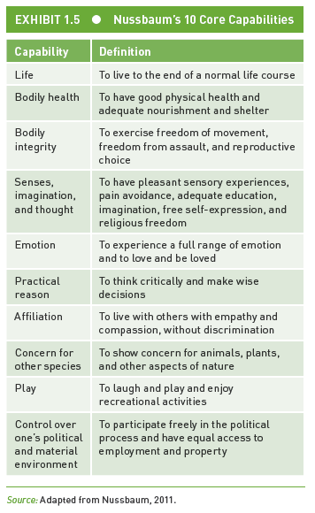
Advancing Human Rights and Social, Economic, and Environmental Justice
Hutchison, Dimensions of Human Behavior, 6e
SAGE Publishing, 2019

Slide 39
Knowing and Doing
4 ingredients of “knowing how” to do social work
  Knowledge about the case
    Develop understanding of situation
    Select and order information
    Influenced by relationship quality
  Knowledge about the self
    Understanding one’s own thinking processes, emotions, and social location
Hutchison, Dimensions of Human Behavior, 6e
SAGE Publishing, 2019

Slide 40
Knowing and Doing
  Values and ethics
    Established by NASW
    Knowledge of self—critical to ethics
  Scientific knowledge
Hutchison, Dimensions of Human Behavior, 6e
SAGE Publishing, 2019

Slide 41
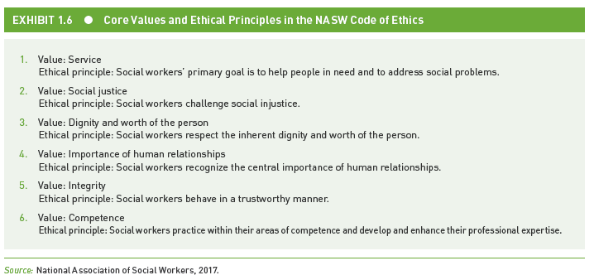
Values and Ethics
Hutchison, Dimensions of Human Behavior, 6e
SAGE Publishing, 2019

Slide 42
Scientific Knowledge: Theory and Research
Hypotheses
  Tentative statements to be explored/tested
  Not facts
Theory
  Interrelated set of concepts and propositions, organized into a deductive system
  Explains relationships among aspects of our world
Hutchison, Dimensions of Human Behavior, 6e
SAGE Publishing, 2019

Slide 43
Scientific Knowledge: Theory and Research
  Provides framework for understanding person/environment transactions
  Guides interventions
  Focuses attention on particular aspects of the person–environment–time configuration
Hutchison, Dimensions of Human Behavior, 6e
SAGE Publishing, 2019

Slide 44
Theory and Research
  Concepts
    Building blocks of theory
  Propositions
    Assertions
  Deductive reasoning
    Use propositions to generate specific hypotheses to test
Hutchison, Dimensions of Human Behavior, 6e
SAGE Publishing, 2019

Slide 45
Theory and Research
  Assumptions
      Beliefs held to be true without testing or proof
Needs to be objective
Empirical research
  Careful, purposeful, and systematic observation of events with the intent to note and record them in terms of their attributes, to look for patterns in those events, and make our methods and observations public
Hutchison, Dimensions of Human Behavior, 6e
SAGE Publishing, 2019

Slide 46
Theory and Research
  A problem-solving process
  Experienced through our senses, as opposed to something that we experience purely in our minds
  Tests the assumptions of theories
Hutchison, Dimensions of Human Behavior, 6e
SAGE Publishing, 2019

Slide 47
Theory and Research
Empirical research
  Positivist perspective
    World has order that can be discovered, findings can be applied to other groups, findings are tentative, scientific methods are value-free
    Quantitative methods of research
      Measures concepts, standardize collection of data, attend to preselected variables, use statistical measures
Hutchison, Dimensions of Human Behavior, 6e
SAGE Publishing, 2019

Slide 48
Theory and Research
Empirical research
  Interpretist perspective (constructivist)
    Assume that reality is based on people’s definitions of it
    Qualitative methods of research
      Flexible, experiential, captures how participants view social life
Hutchison, Dimensions of Human Behavior, 6e
SAGE Publishing, 2019

Slide 49
Theory and Research
  Postpositivism
    Philosophical position
    Recognizes complexity of reality and limitations of human observers
Hutchison, Dimensions of Human Behavior, 6e
SAGE Publishing, 2019

Slide 50
Critical Use of Theory and Research
Critical thinking
  Thoughtful/reflective judgment about alternative views
  Why is it important?
Hutchison, Dimensions of Human Behavior, 6e
SAGE Publishing, 2019

Slide 51
Critical Use of Theory and Research
Criteria for evaluating theory
  Coherence and conceptual clarity
  Testability and evidence of empirical support
  Comprehensiveness
  Consistency with social work’s emphasis on diversity and power arrangements
  Usefulness for social work practice
Hutchison, Dimensions of Human Behavior, 6e
SAGE Publishing, 2019

Slide 52
Critical Use of Theory and Research
  Corroboration
  Multidimensionality
  Definition of terms
  Limitation of sample
  Influence of setting
  Influence of the researcher
  Social distance
  Specification of inferences
  Suitability of measures
Hutchison, Dimensions of Human Behavior, 6e
SAGE Publishing, 2019

Slide 53
Critical Use of Theory and Research
Bias
  What is it?
  Can occur at all stages of research
  How does it affect research?
In summary:
  Theory = ideas or assumptions about what is happening and why
  Research = evidence based, what we can see, hear, feel about what is happening
Hutchison, Dimensions of Human Behavior, 6e
SAGE Publishing, 2019

Slide 54
A Word of Caution
Textbook presents personal and environmental dimensions separately
  Note that person and environment cannot be separated when thinking about human behavior
    Approach has been taken for several reasons:
      Personal and environmental dimensions have been studied separately
      Introduce dimensions not typically covered in social work textbooks
      Ensure collective behavior receives attention it deserves
Hutchison, Dimensions of Human Behavior, 6e
SAGE Publishing, 2019

